Slide 1
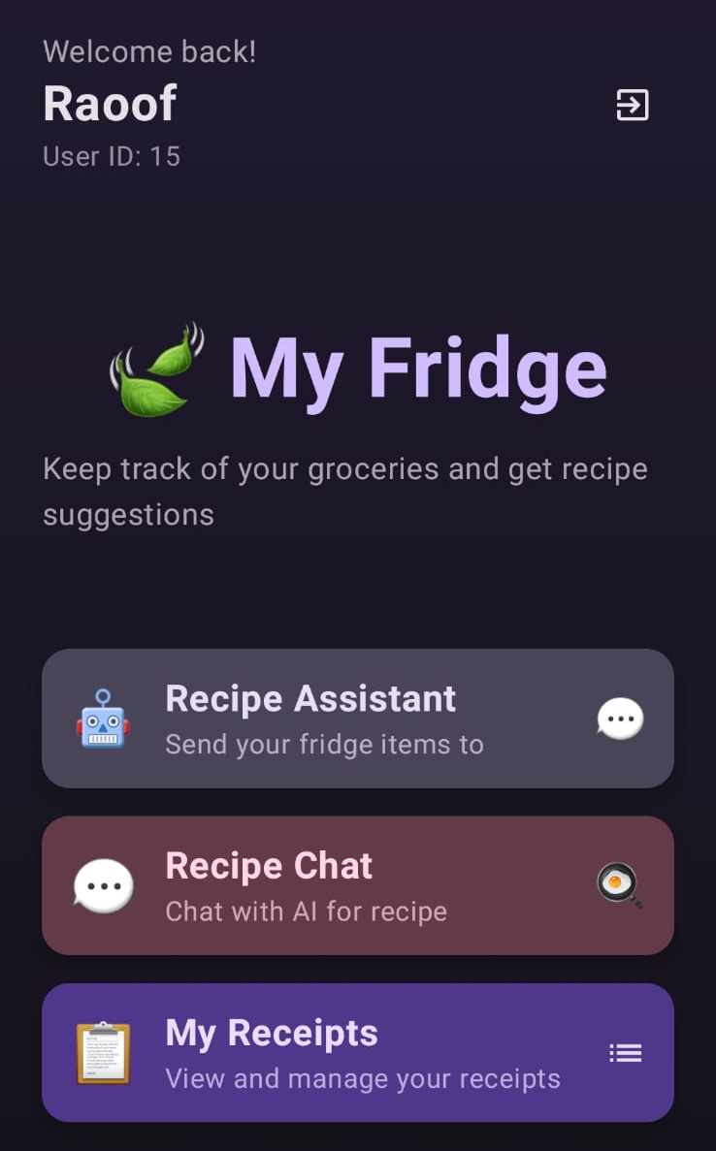
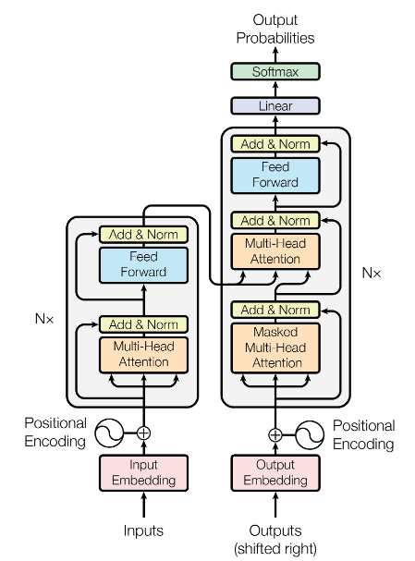
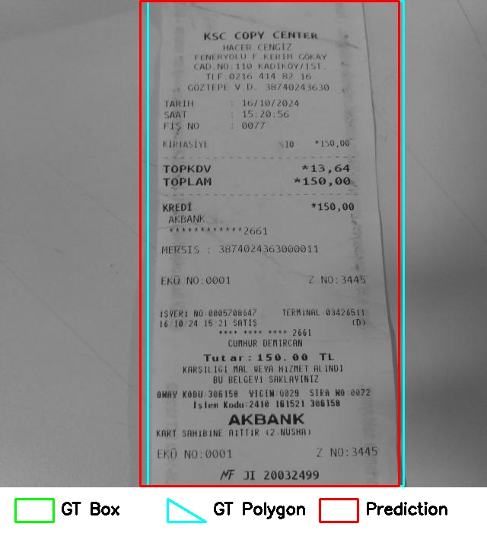
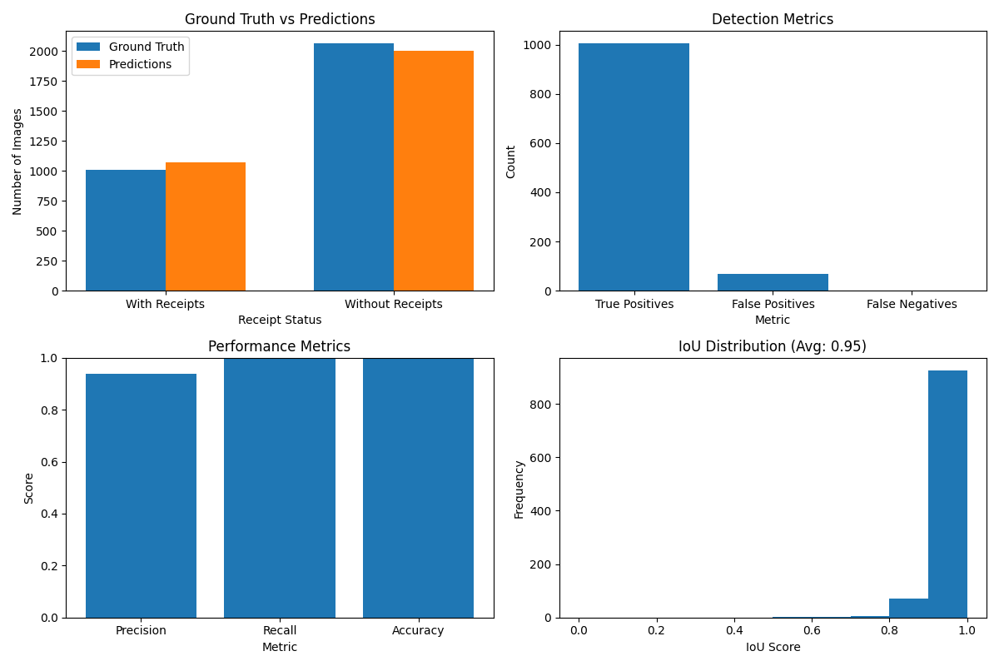
Design and Development of an OCR-Based Android Application for Receipt Reading and Recipe Recommendation Using Large Language Models
Raoof Agh, Taylan Başar Duyğun, Özgur Uylaş
Serhat Özekes
Abstract
This project introduces My Fridge, an Android application that combines object detection (YOLOv8), OCR, and large language models (LLMs) to manage fridge contents and recommend personalized recipes. The app scans receipts using the camera, extracts product details via OCR, and stores them in a secure backend. A chat-based assistant, powered by an LLM, helps users explore recipe suggestions based on their inventory. Despite OCR limitations on local devices, the system achieves high detection accuracy and serves as a practical tool for smart kitchen management.
Keywords
Smart Fridge, Android App, YOLOv8, OCR, Large Language Model, Recipe Recommendation, Object Detection, Mobile Vision, Jetpack Compose
IV. API
To transfer receipt data, user information, and recipes, we designed an intercommunicating API architecture. Currently, there are five APIs in total. Each API is responsible for its own specific task—for example, the OCR API handles receipt processing, while the DB API manages all database operations.
In this architecture, the Main API functions as the orchestrator, connecting all other APIs and routing each request to the appropriate service. This modular structure allows for a more dynamic, maintainable, and scalable system them.
IV. LLM
Recipe Recommendation Process Based on OCR and LLM Technologies
I. Introduction
Managing food inventory efficiently is a growing need in modern households. People often forget what they’ve purchased, leading to food waste and missed opportunities for creative cooking. My Fridge addresses this issue by providing an intelligent, mobile-based solution that automates food tracking and offers personalized recipe suggestions based on available ingredients.
The system combines state-of-the-art technologies, including YOLOv8 for receipt object detection, OCR for extracting product names and prices, and Large Language Models (LLMs) for generating relevant recipes and guiding users via chat-based interaction. Developed as an Android application using Jetpack Compose and MVVM architecture, My Fridge connects to a secure backend and provides users with a clean, intuitive interface.
This multidisciplinary project brings together computer vision, natural language processing, and mobile development, creating a practical and extensible tool that enhances everyday life in the kitchen.
When a new feature is needed or an existing one requires an update, changes can be made only within the relevant domain-specific API and the Main API, without affecting the rest of the system. All APIs were developed using the Spring Framework.
This API structure serves as the skeletal and circulatory system of the project. It enables seamless data transfer between the OCR and LLM modules and the database, while also handling communication with the mobile application. Since the final system integrates four major components, this architecture ensures smooth and synchronized interaction between
In the proposed system, structured data extracted from market receipts through OCR is routed to the LLM module, where personalized recipe suggestions are generated by analyzing the user's dietary preferences, available ingredients, and historical consumption patterns.
During development, multiple large language models—namely OpenAI GPT-3.5, Hugging Face models, and the Google Gemini API—were rigorously evaluated. Google Gemini 1.5 Flash was ultimately selected for its superior contextual coherence, semantic precision, and overall response consistency.
Beyond recipe generation, the LLM module also plays a critical role in refining OCR outputs by enhancing semantic clarity, correcting noisy or ambiguous product names, and transforming raw data into fluent and contextually appropriate natural language expressions.
II. Principle
The scope of the conference includes principally the following topics:
YOLOv8 Object Detection
OCR with Tesseract
Large Language Model (LLM) for Recipe Generation
MVVM ArchitectureJetpack Compose UI
RESTful API Backend
Kotlin Coroutines & StateFlow
Secure Data Storage
Real-time Mobile Inference
The Transformer architecture is a groundbreaking model in the field of natural language processing, built upon an encoder–decoder framework. Input data is first converted into numerical vectors via Input Embedding, and then enriched with Positional Encoding to preserve the sequential order of tokens. Each encoder layer comprises a Multi-Head Attention mechanism, Add & Norm operations, and Feed Forward networks, typically repeated N times to deepen contextual understanding.
On the decoder side, Masked Multi-Head Attention is initially employed to maintain the autoregressive nature of sequence generation, followed by standard attention over the encoder’s outputs to refine the representation.
The final prediction probabilities are obtained through Linear and Softmax layers. Unlike recurrent architectures such as RNNs, the Transformer leverages parallel computation, allowing for significantly faster processing and richer contextual representations. Its self-attention mechanism enables the model to capture intricate relationships between words across the entire sequence, leading to a more accurate comprehension of meaning.
As a result, the Transformer excels in a wide range of NLP tasks—such as machine translation, summarization, and text generation—by producing robust linguistic representations at both the word and sentence levels.
III. YOLOv8/OCR
To extract product and pricing information from shopping receipts, we implemented a two-stage system using YOLOv8 and Tesseract OCR.
A custom YOLOv8 model was trained on a diverse set of receipt images to detect both the overall receipt and individual text areas, including item names and price fields. The model achieved high accuracy and was optimized for real-time use on Android devices.
Once the relevant regions were detected, Tesseract OCR was used to recognize and convert the text into structured data. While Tesseract performed well in cloud environments like Google Colab, local performance was affected by limited support for Turkish language, font inconsistencies, and noise in real-world images.
Several preprocessing techniques—such as adaptive thresholding and image denoising—were applied to improve OCR results, but accuracy still varied depending on input quality.
This detection and recognition pipeline forms the foundation for automatically updating fridge contents and enabling recipe generation based on the user’s latest purchases.
The developed user interface is activated via the Gemini API key. Product data extracted through the OCR module is processed using a Large Language Model (Google Gemini 1.5 Flash), through which the system generates three personalized recipe suggestions.
Any missing ingredients for each recipe are clearly indicated, enabling the user to select the most suitable option based on their available resources. Additionally, complementary suggestions such as beverage pairings are provided to enhance the overall user experience.
With features like Nutritional Information, Daily Calorie Requirement, Shopping List, and Mood-Based Recipes, the interface functions as a personalized kitchen management tool.
Fig. 1. YOLOv8 Test
Fig. 2. YOLOv8 training results

